Slide 1
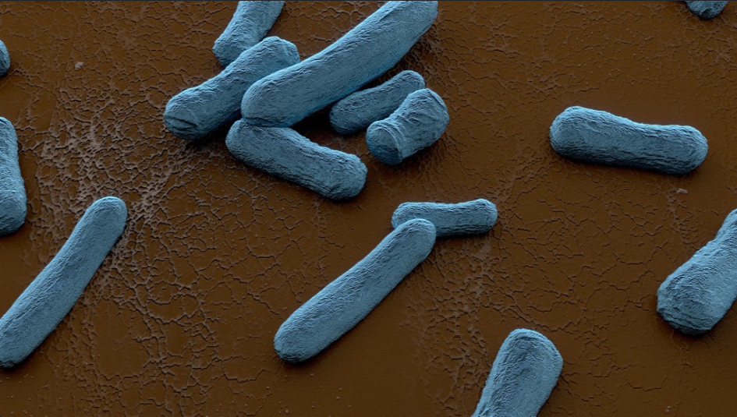
Title
Affiliation
This section describes the research findings.
In the case that the research does not have results yet, you should describe the preliminary data or results with some statistical work.
If you expect to have results before the conference, the poster can include a note that a finalized version of the abstract will be updated at a later date before the conference.
The purpose of the results section is to provide a clear and concise presentation of the data and to highlight the main findings of the study. It is important to organize the results in a logical and easy-to-follow manner, using headings, subheadings, and bullet points to help guide the reader through the information.

